Slide 1
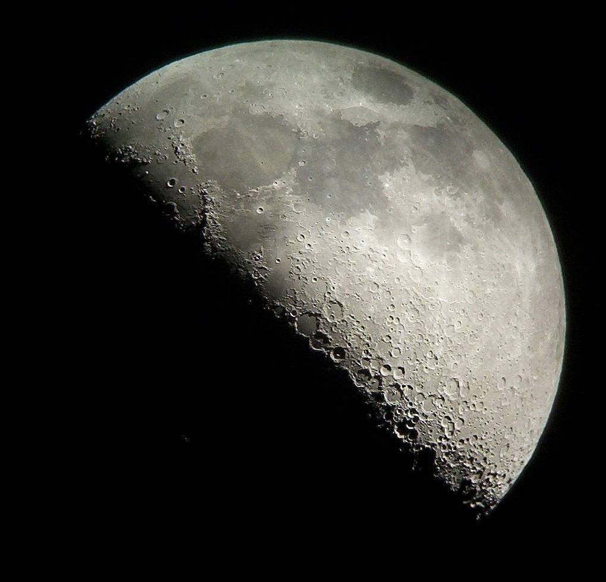
The Moon

Slide 2
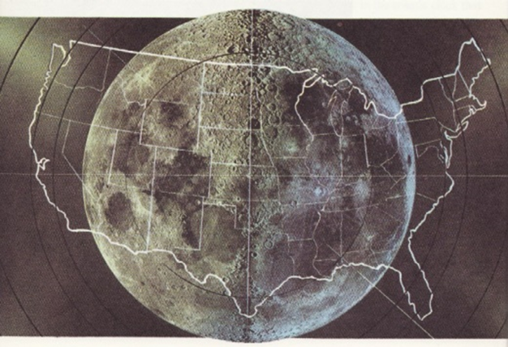
The diameter of the moon is 2,159 miles (Kansas is 400 x 200 miles).

Slide 3

The Moon
Orbit Distance is 238,855 miles
Orbit Period is 27.3 days
Surface Temperature ranges between -387⁰ to 253⁰ F
The surface area of the Moon is 14,658,000 square miles or 9.4 billion acres

Slide 4
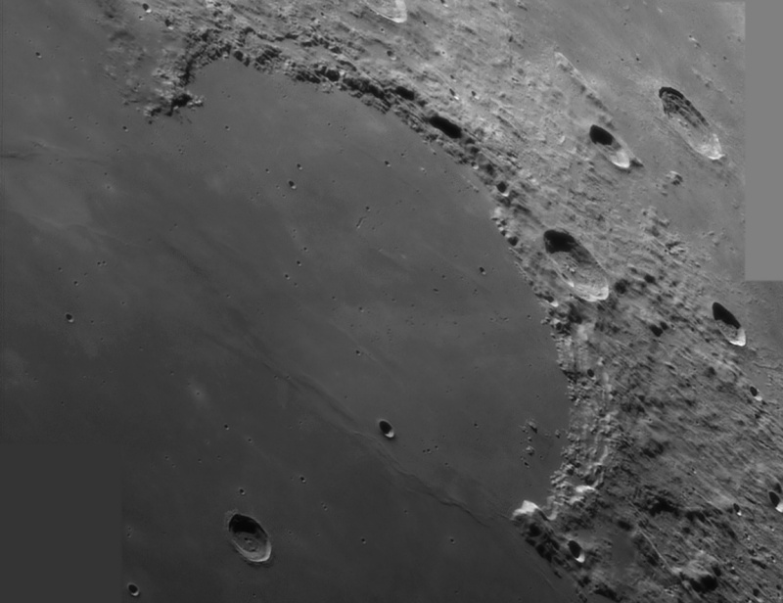
The smooth parts are called “maria”, which is Latin for “seas.”
A mare is formed when:
  There is in impact from an asteroid, forming a crater.
  The impact cracks the underlying rock layers.
  Hundreds of millions of years later, magma travels up the fractures, filling in the crater basin with basalt, smoothing it out. Basalt is a very dense material.

Slide 5
There are very little maria on the far side of the Moon…but we don’t really know why that is.

Slide 6
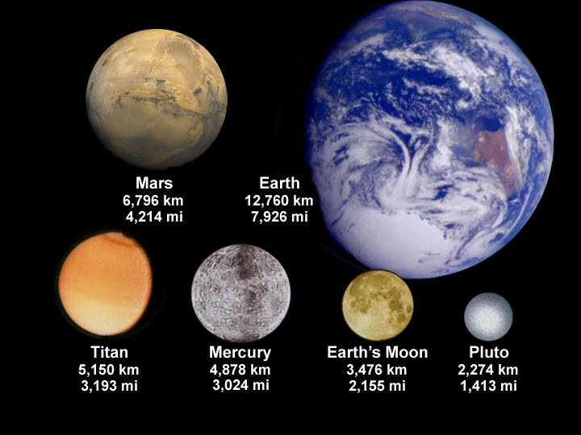

Slide 7
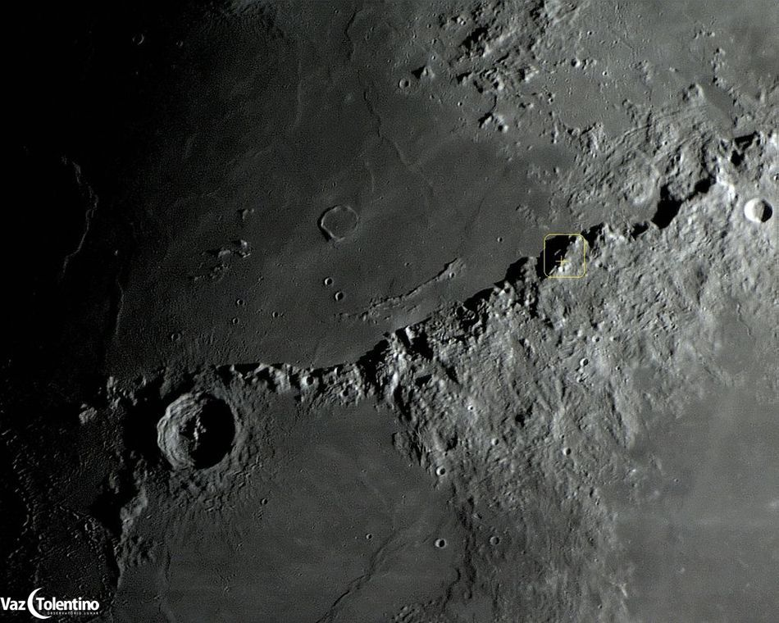
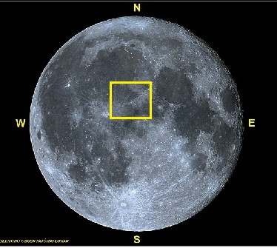
Mons Huygens is the tallest mountain on the Moon. It is 4700 meters tall (15,419ft), just over half the height of Mt Everest (8848m or 29,000ft).

Slide 8
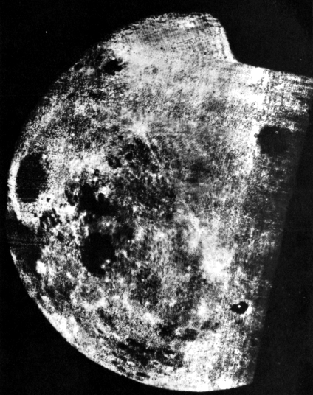
This is the first ever photo of the far side of the Moon. It was taken by the Soviet mission, Luna 3, on October 1959.

Slide 9
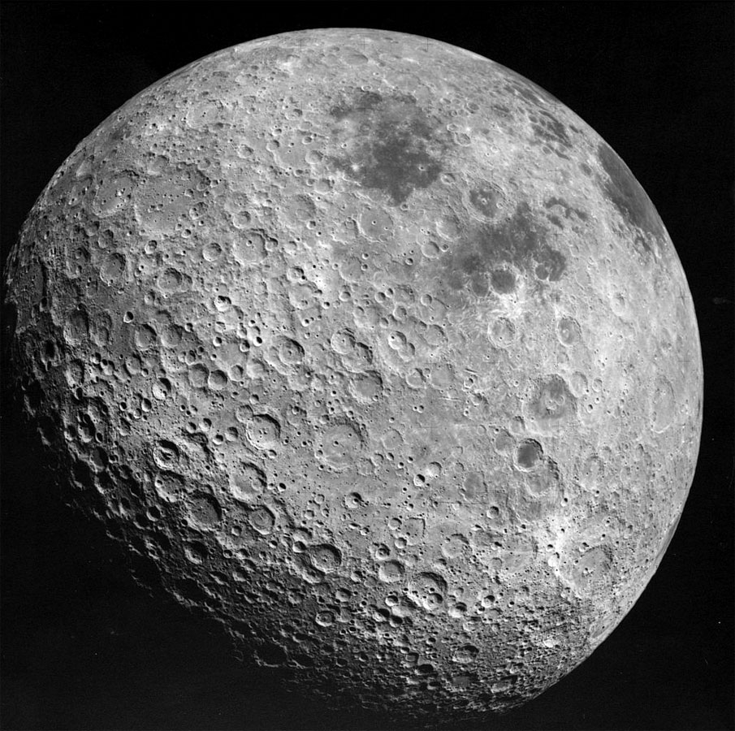
The far side of the Moon.

Slide 10
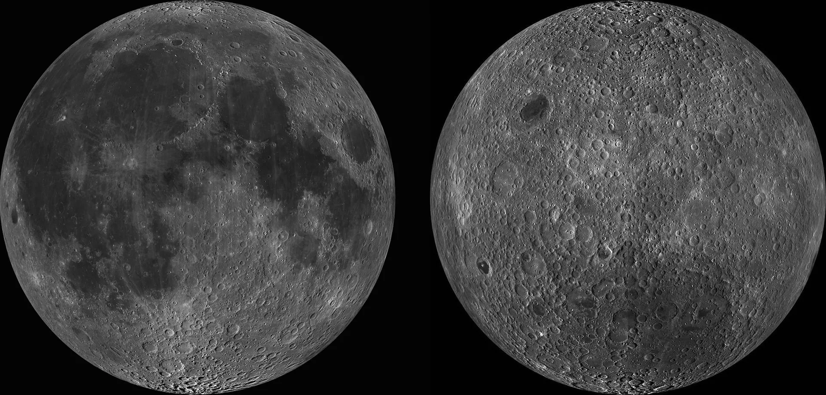
The near side of the Moon.
The far side of the Moon.

